Slide 1
“ IT Help Desk ”
Project By – Harshdeep Marathe.
Seat No. - 13970
MCA (2014-16)
Under Guide – Prof. Kumar Pawar.

Slide 2
Company Profile
“Prudency's Solution” is IT system integration, professional service and software development companies in Pune that works with Enterprise systems and companies As a privately owned company.
Prudency's Solution provides software design, and development, Training, Consultancy, as well as professional End-to-End Information Technology (IT) services. (Service Based Company).

Slide 3
Purpose
To Provide An Organizational structure that will effectively support our employees, and to ensure orderly reporting of problem resolution.

Slide 4
Scope Of Project
IT Helpdesk allows managing support services more efficiently by treating each and every incoming request as a unique traceable ticket.
Get support requests sent by users into a help desk solution that both empowers support agents and reassures end-users of quick, efficient and quality support.

Slide 5
Scope for System
Send SMS to Particular Technical Staff on bases of Ticket Priority.
Email Status of Ticket as feedback to User.
Share Ticket workload among Technical Staff.
Backup and Restore.

Slide 6
Hardware & Software Requirements
Operating systems –
Compatible with Microsoft Windows operating system versions 2003,
XP Professional (Service Pack 2),
Vista (Service Pack 1),
Windows 7(Service Pack 1) and SQL Server 2012.

Slide 7
Software Specification
FRONT END : Visual Studio.NET 2008
BACK END : MS SQL Server 2005
WEB SERVER : IIS 7 (Internet Information Services)
TECHNOLOGY : .NET Framework 3.5(ASP.NET with VB.NET)

Slide 8
Hardware Specification
CPU : INTEL PENTIUM 4
CLOCK SPEED : 2.8 GHz
MAIN MEMORY : 512 MB
SECONDRY MEMORY : 4 GB
CACHE MEMORY : 1 MB
MONITOR : SVGA

Slide 9
Objectives
Provide One Central point of contact for problem resolution and inquiry.
Provide one centralized problem management system.
Provide high level of technical expertise to support our employees.

Slide 10
Features And Benefits
Questions and problems will be logged on-line.
Multiple screens will provide employees with history of opened and closed tickets.
Employees will be able to communicate electronically via email to inquire about the status.

Slide 11
Diagrams Module Hierarchy Diagram

Slide 12
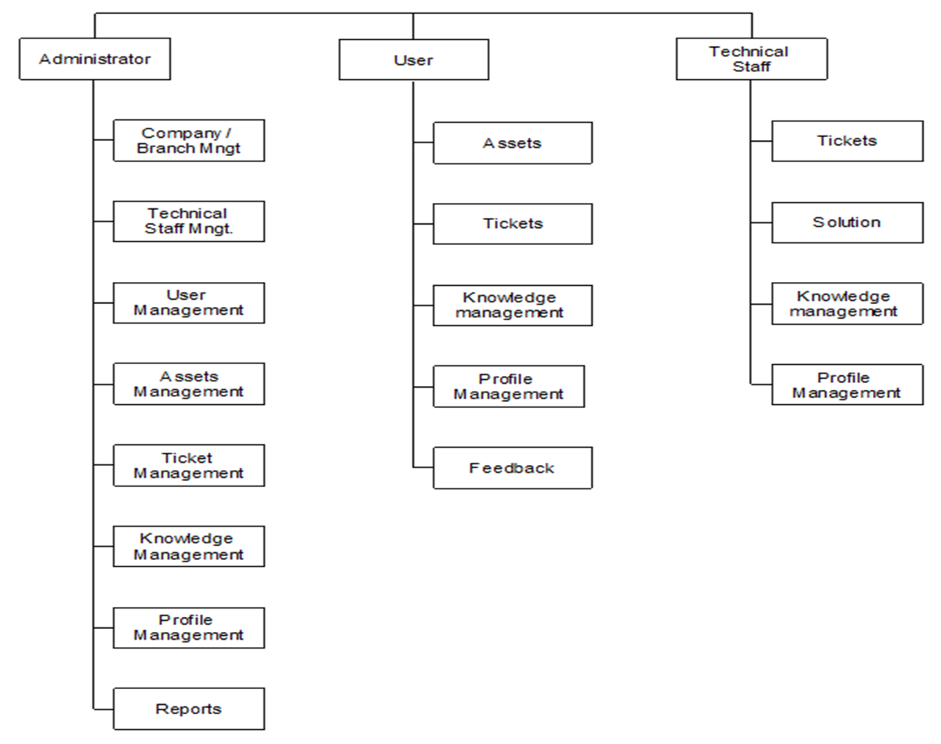

Slide 13
Entity Relationship Diagram

Slide 14
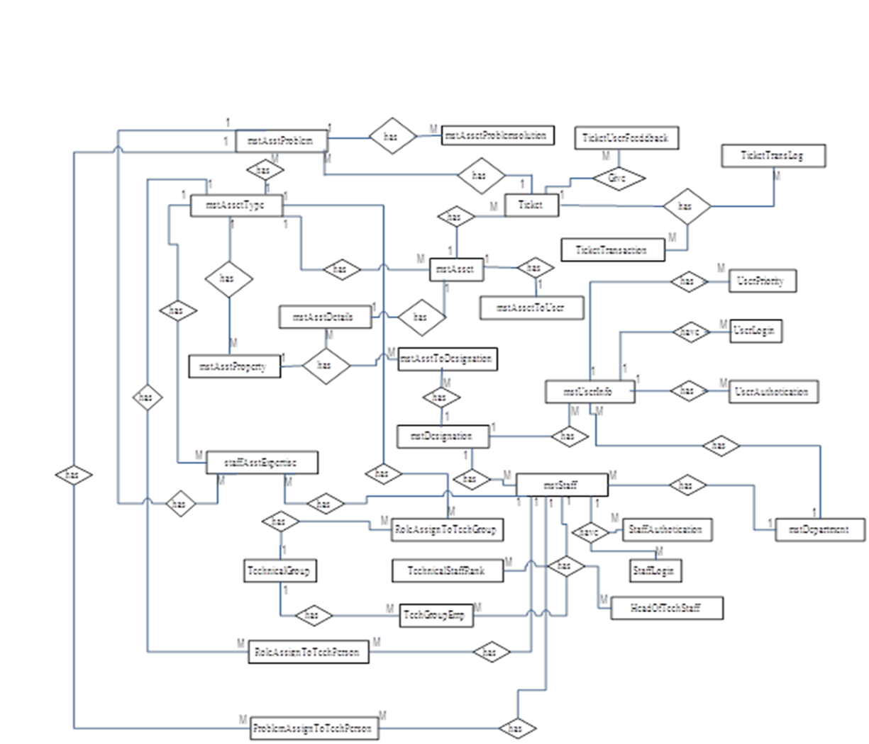

Slide 15
Use Case Diagram for Administrator

Slide 16
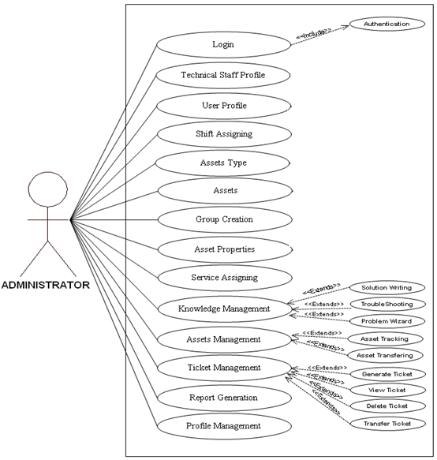

Slide 17
Use Case Diagram for User

Slide 18
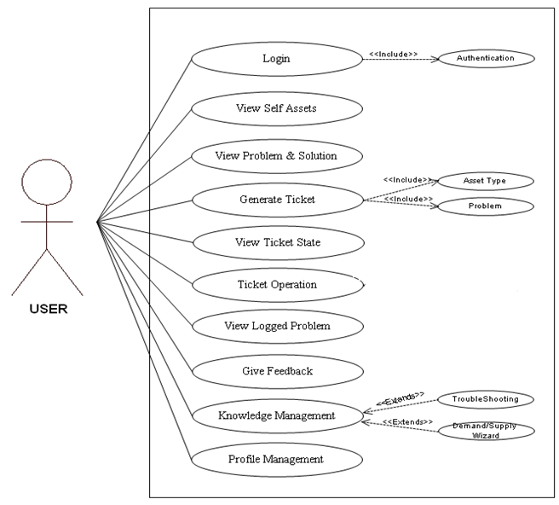

Slide 19
Use Case Diagram for Technical Staff

Slide 20
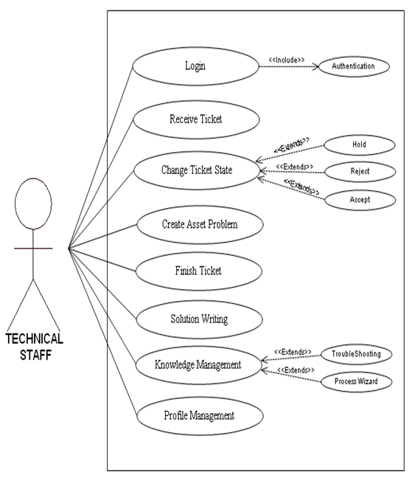

Slide 21
Sequence Diagram for Login

Slide 22
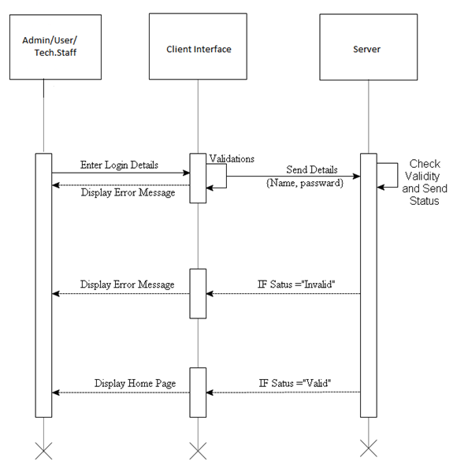

Slide 23
Sequence Diagram for Administrator

Slide 24
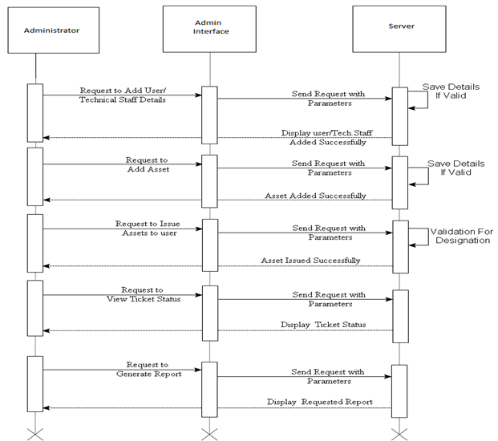

Slide 25
Sequence Diagram for Technical Staff

Slide 26
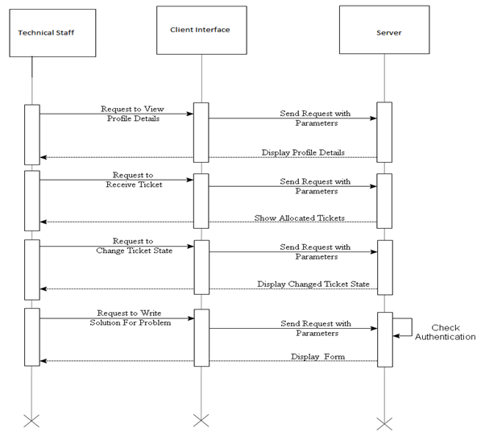

Slide 27
Sequence Diagram for user

Slide 28
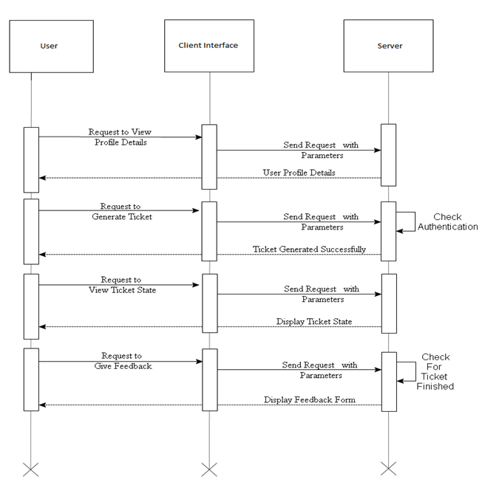

Slide 29
Activity Diagram for Login

Slide 30
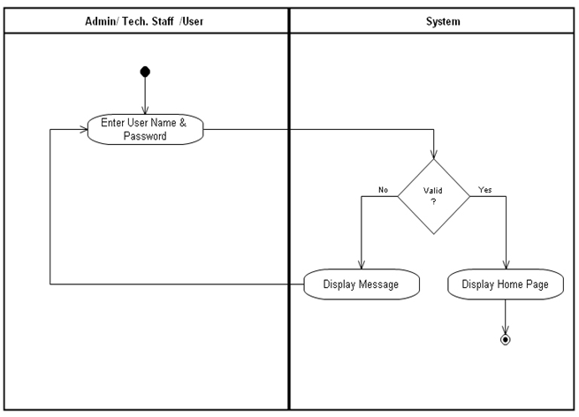

Slide 31
Activity Diagram for Add User/Technical Staff

Slide 32
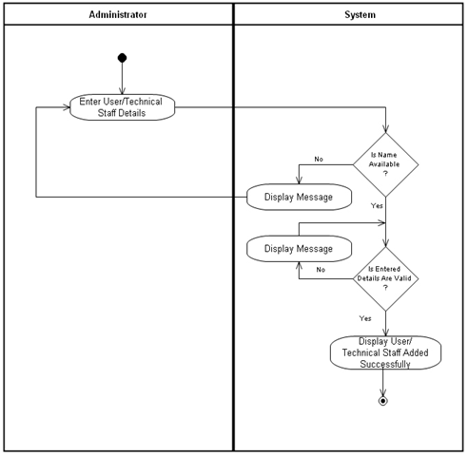

Slide 33
Activity Diagram for Issue Assets To User

Slide 34
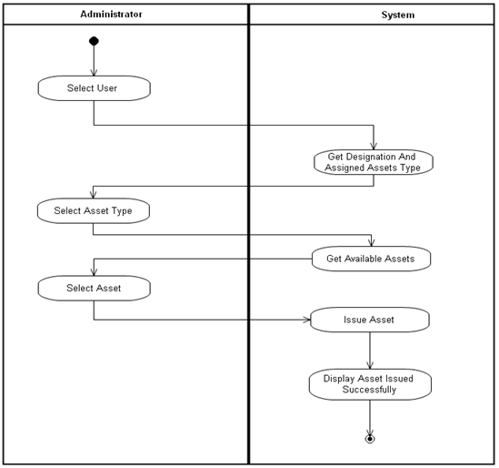

Slide 35
COMPONENT DIAGRAM

Slide 36
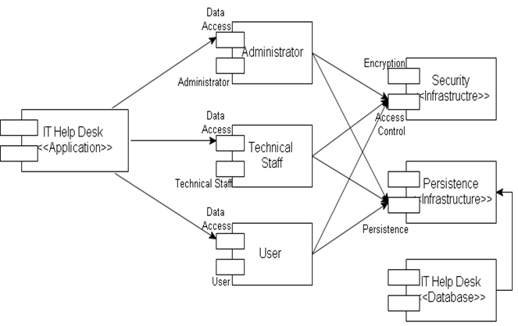

Slide 37
DEPLOYMENT DIAGRAM

Slide 38
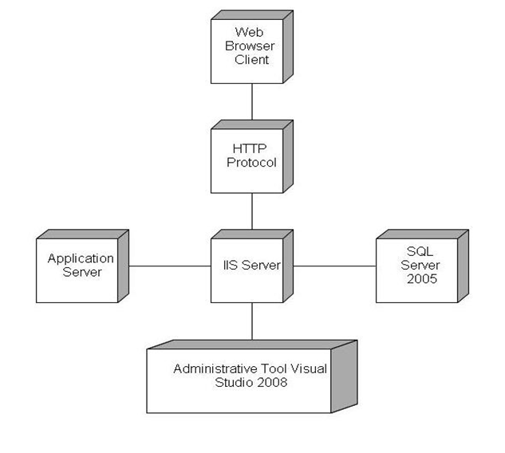

Slide 39
INPUT SCREENS Home Page Screen

Slide 40


Slide 41
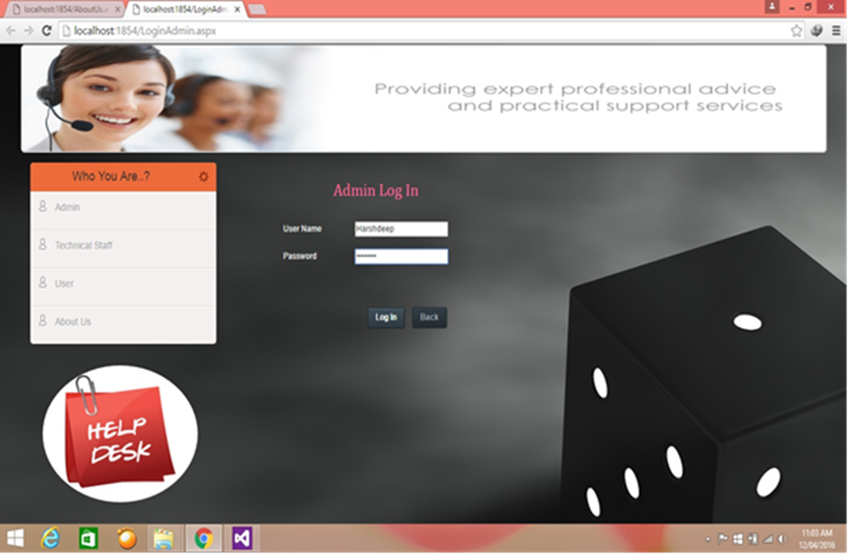
Admin Login Screen

Slide 42
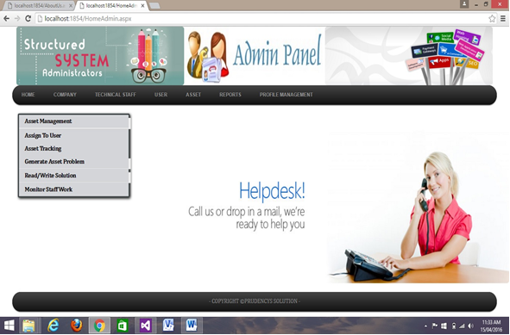
Admin Home Screen

Slide 43
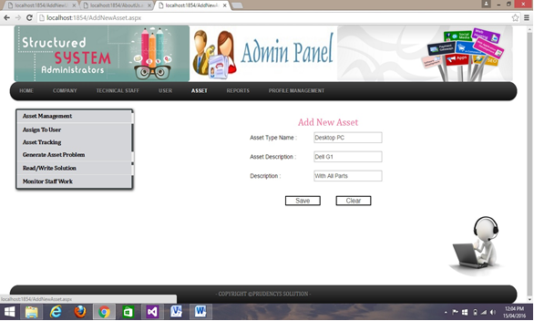
Add New Asset Screen

Slide 44
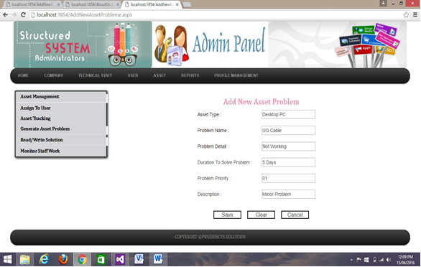
To add new asset problem Screen

Slide 45
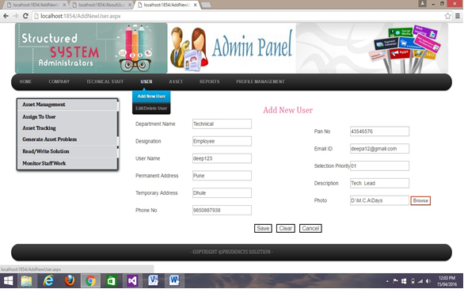
Add New User in the System

Slide 46
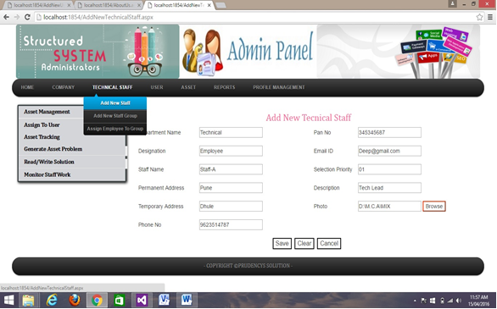
Add New Technical Staff

Slide 47
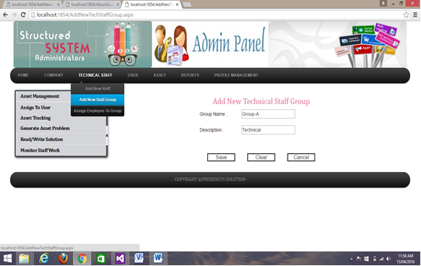
Add New Technical Staff Group

Slide 48
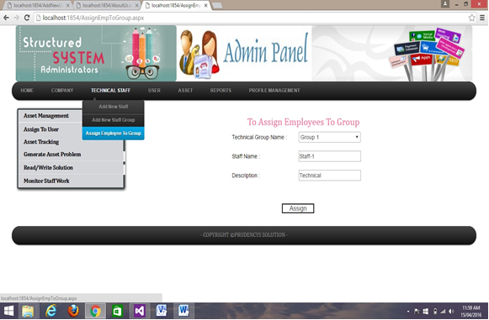
Assign Employees To Group

Slide 49
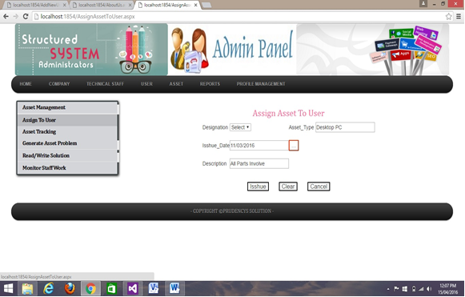
Assigning Asset to User

Slide 50
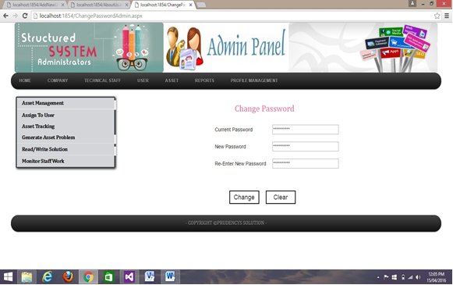
Change Password (Admin)

Slide 51
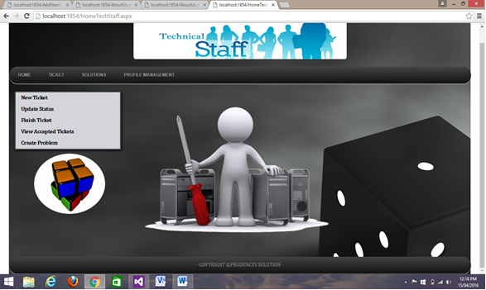
Technical Staff Home Screen

Slide 52
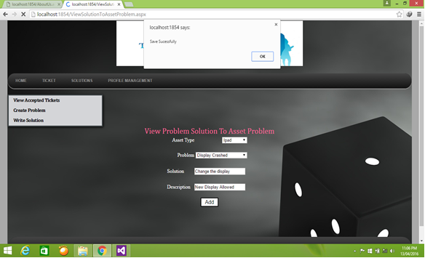
Solution To Asset Problem

Slide 53
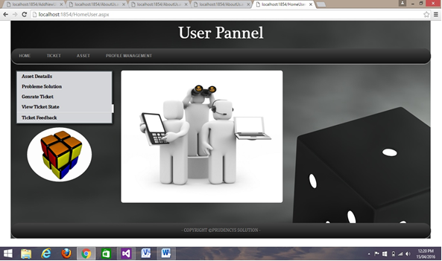
User Home Screen

Slide 54
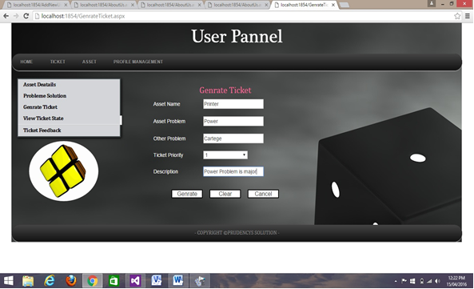
Generate Ticket Screen

Slide 55
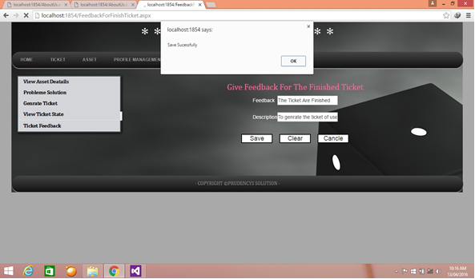
Feedback Screen

Slide 56
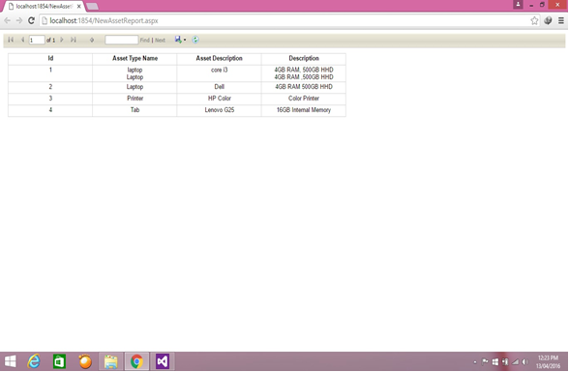
All Asset Details (Report)

Slide 57
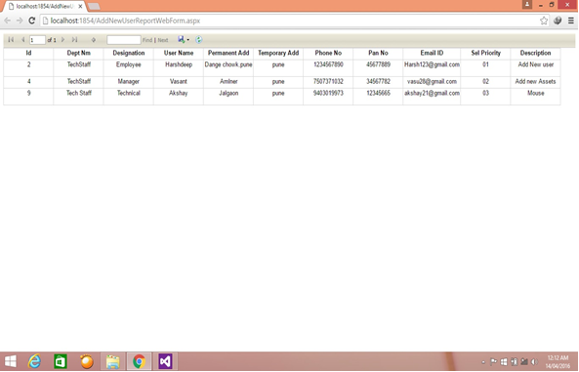
User & Login Details (Report)

Slide 58
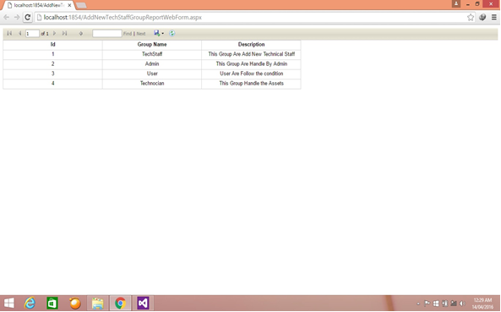
Technical Group Details (Report)

Slide 59
Data Tables
Admin Log In
Sr. No. | Fields Name | Data Type | Size | Constraints
1 | numStaff_Login_Id | bigint | - | PK
2 | nvcharStaffLoginName | nvarchar | 50 | Not null
3 | nvcharStaffPassword | nvarchar | 50 | Not null

Slide 60
Asset Details
Sr. No. | Fields Name | Data Type | Size | Constraints
1 | numAsset_Id | bigint | - | FK
2 | numAsset_Name | nvarchar | 100 | FK
3 | nvcharAsset_Info | nvarchar | 50 | Not null
4 | nvcharDescription | nvarchar | MAX | -

Slide 61
Asset Problem
Sr. No. | Fields Name | Data Type | Size | Constraints
1 | numAssetproblem_Id | bigint | - | PK
2 | numAsset_Type_Id | bigint | - | FK
3 | nvcharAsset_Problem_Name | nvarchar | 50 | Not null
4 | nvcharAsset_Problem_detail | narchar | MAX | Not null
5 | dtDurationToSolveProblem | datetime | - | Not null
6 | nvcharDescription | bvarchar | MAX | -

Slide 62
Assets To User
Sr. No. | Fields Name | Data Type | Size | Constraints
1 | numAssetsToUser_Id | bigint | - | PK
2 | numUser_Id | bgint | - | FK
3 | numAsset_Id | bgint | - | FK
4 | dtDateofIssued | datetime | - | Not null
5 | nvcharDescription | nvarchar | MAX | -
6 | ynDeleted | Bit |  | -

Slide 63
Add New User
Sr. No. | Fields Name | Data Type | Size | Constraints
1 | numUser_Id | bigint | - | PK
2 | numDepartment_Id | bigint | - | FK
3 | numDesignation_Id | bigint | - | FK
4 | nvcharUser_Name | nvarchar | 50 | Not null
5 | nvcharUser_Parmant_Address | nvarchar | MAX | Not null
6 | numUser_Phone_Number | bigint |  | -
7 | nvcharUser_Email_Id | nvarchar | 50 | Not null
8 | numUserPriorityLevel | bigint |  | Not null
9 | imgUser_Photo | image |  | -
10 | nvcharDescription | nvarchar | MAX | -

Slide 64
CONCLUSION
The system is able to achieve the objective and provide the ultimate result called “CUSTOMER SATISFACTION”.
Developing the project has helped me to gain some experience on real-time development Procedures.

Slide 65
Thank You

